Slide 1

PROJECT-BASED LEARNING
PHASE-2 EVALUATION
SMART STUDENT ACADEMIC ASSISTANT
Team ID: IDS-III-2026-T021
Department of Computer Application
Graphic Era (Deemed to be University), Dehradun
Academic Session 2026–27

Slide 2
Team & Mentor Details
Team Information
Team Members
Team ID: Semester: Section: Domain:
IDS-III-2026-T021
3rd
G4
BCA
Bhavya Sharma-2510530423
Samriddhi Gaur. -2510320436
Nisha Rana. -2510320527
Mentor Ms. Shivani Sharma
2/10

Slide 3
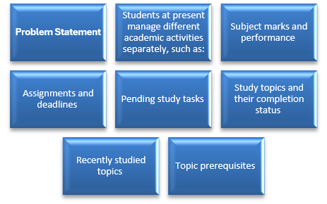
Problem Statement
Problem Statement
Students needs to manage different academic activities such as marks, assignments, deadlines and study topics.
Our project aims to bring these activities together in one system and use DSA to organize and process the information.

Slide 4
Objectives
Project Objectives
Store student and subject information.
Analyse the marks and identify the subjects requiring more attention.
Prioritize assignments according to their urgency.
Maintain the pending and completed study tasks.
Track recently studied topics.
Represent topic prerequisites using a graph.
Provide simple rule-based study recommendations.
Key Objective: to apply DSA to a real student-related problem.

Slide 5
Work Completed So Far
C/DSA
Student and subject structures created.
Assignment management implemented.
Topic management implemented.
Linked list functionality added for assignments.
Priority queue implemented for assignment priority.
Stack implemented for study history.
Topic dependency graph implemented.
BFS and DFS implemented.
Rule-based recommendation functions added.
Database
SQLite database has been created with:
student
subject
assignment
topic

Slide 6
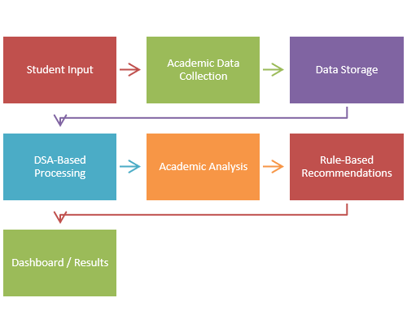
Current & Planned System Workflow
Student(Enter\view information)
Frontend HTML+ CSS+ JavaScript (dashboard, profile, marks, assignments, study planner, recommendations, topic dependencies)
Backend. (Python flask)
Database operations SQLite (student, subjects,, assignment assignments, topics, study history)
DSA processing C DSA engine (Arrays/structures, linked list, queue, priority, Queue, stack, graph, search/sort/BFS/DFS)
Academic analysis. (weak subject detection, assignment, priority, topic learning path, Study history, recommendations)
Results. Priority task. Week subjects. Suggested topics. Learning path.

Slide 7
Technology Stack & Functions
Technology Stack
Implemented Functions​
Create topic graph and Generate study recommendations
Display topic dependencies .
BFS study path
DFS traversal
Mark topic as completed
Check prerequisites
Suggest next topic
The current C implementation contains 36 topics and their dependency relationships
Data Structure | Purpose
Array | Store subjects, marks and topics
Structure | Store student, subject, assignment and topic details
Linked List | Manage assignment records dynamically
Queue | Manage tasks
Priority Queue | Prioritize assignments
Stack | Maintain recently studied topics
Graph | Represent topic dependencies

Slide 8
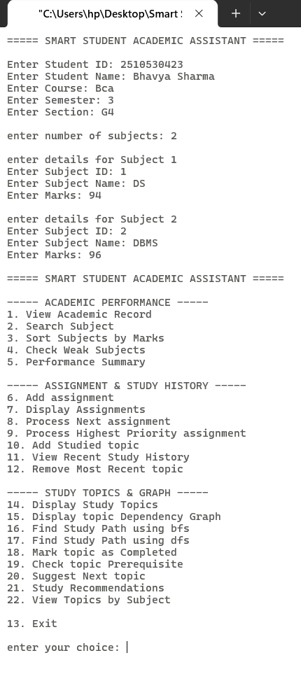
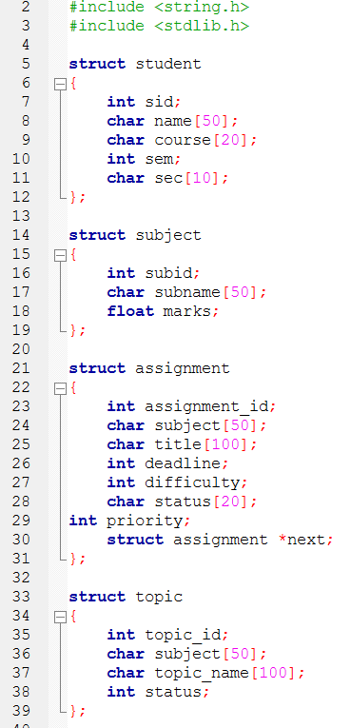
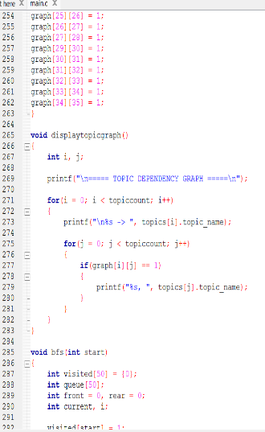
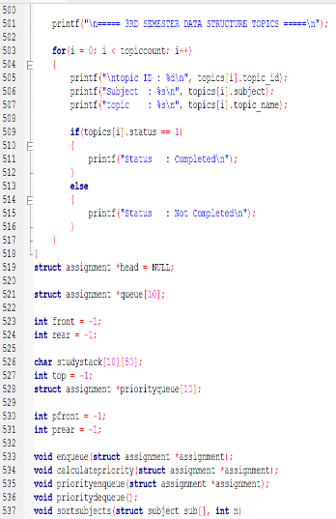
Screenshots and Code Snippets

Slide 9
Team Contribution
Progress Achieved
Individual Contribution
Member | Role | Contribution
Nisha Rana | Student & Academic Performance | Student and subject management ,Marks and performance analysis ,Searching and sorting ,Weak subject identification ,Academic performance functions
Samriddhi Gaur | Assignment & Task Management | Assignment management ,Linked list implementation ,Queue and priority queue ,Assignment prioritization ,Study history / stack
Bhavya Sharma | Study Planner & Recommendations | Topic management ,Topic dependency graph ,BFS and DFS ,Prerequisite checking ,Next-topic suggestions ,Rule-based study recommendations
Common Work | Documentation and Presentation | Project Planning and testing

Slide 10
Remaining Work & Expected Outcome
Remaining Work
Connect C modules with the backend.
Develop Flask APIs.
Connect Flask with SQLite.
Develop HTML/CSS/JavaScript interface.
Display DSA results through the dashboard.
Add topic dependency visualization.
Integrate all three members' modules.
Perform complete testing and debugging
Expected Outcome
A working Smart Student Academic Assistant that combines:
Student Data + DSA Processing + Database + Web Interface + Recommendations
Thank You

